Slide 1
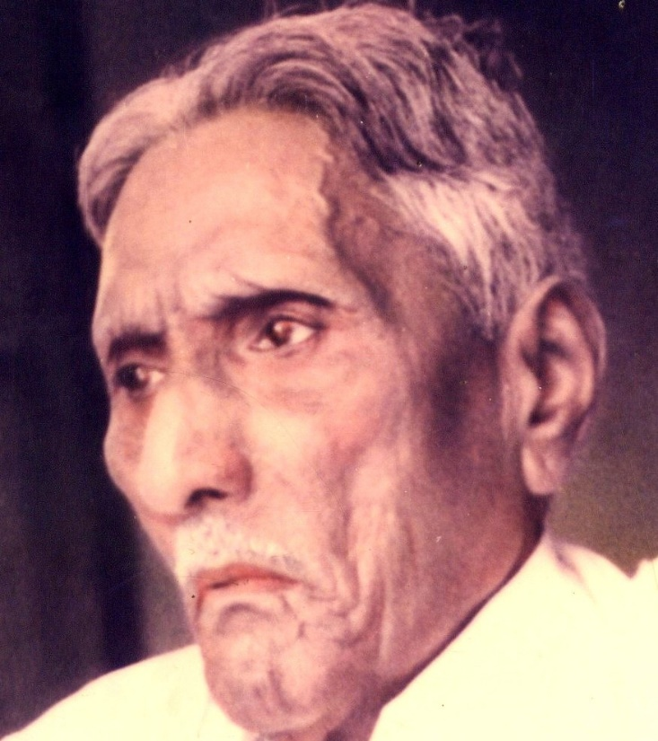

The Bible Mission The Revelation of God to St. M. Devadas The Bible Mission’s Annual Conference

Slide 2
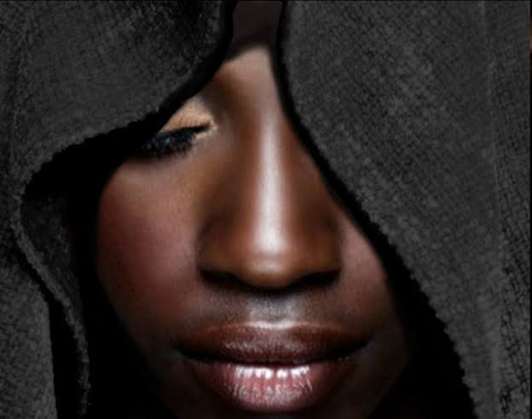
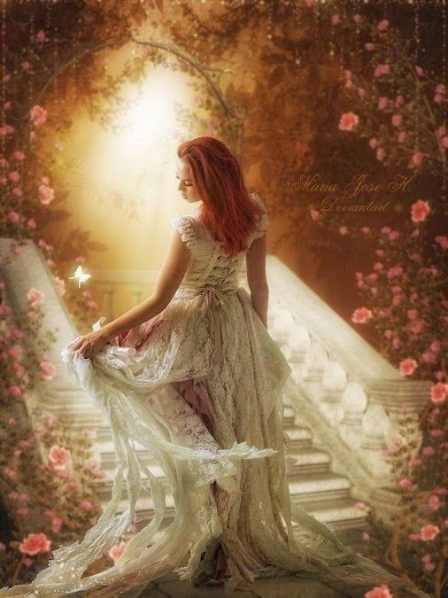
Persecution resulting in the perfection of the Bride in Song of Solomon
Persecution | Perfection
Dark Complexion(1:5) | More Beautiful(4:7)
Being Looked upon(1:6) | Fairest among women(5:9)
Tanned by the Sun(1:6) | Fair as the Moon, Bright as the Sun(6:10)

Slide 3
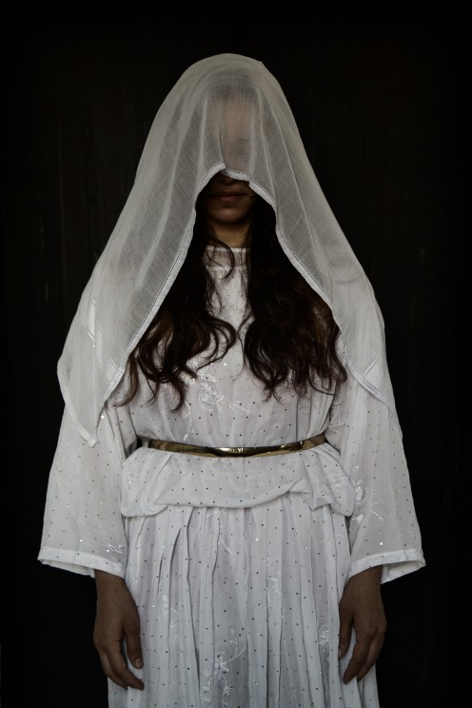
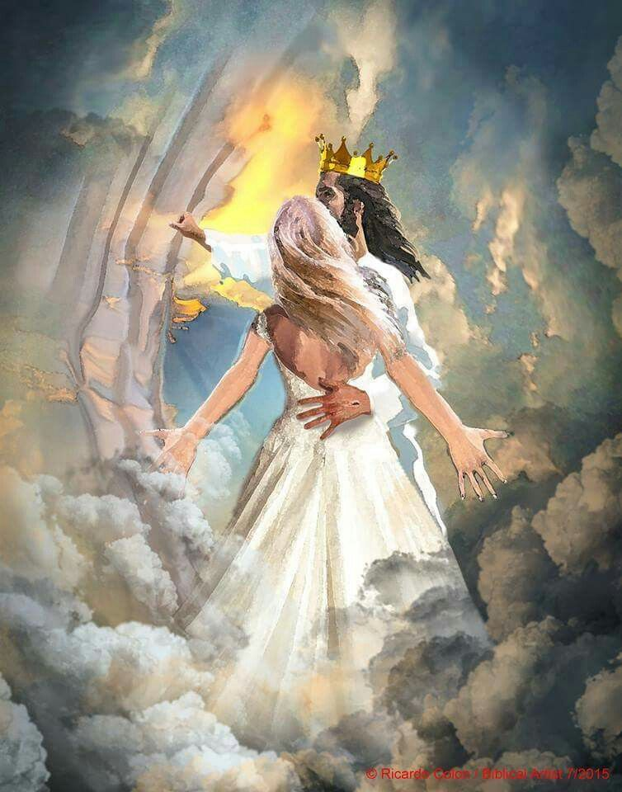
Persecution | Perfection
Anger of Brothers(1:6) | Praised by the Queens(6:9)
Keeper of vineyards(1:6) | An Army with banners(6:10)
Being veiled and made to wait(5:7) | Being crowned like Mount Carmel (3:11)
Being stirred up(8:4) | Being carried in Solomon’s couch(3:7)

Slide 4
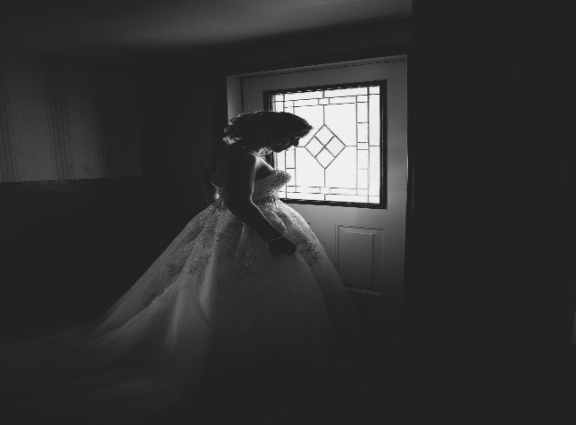
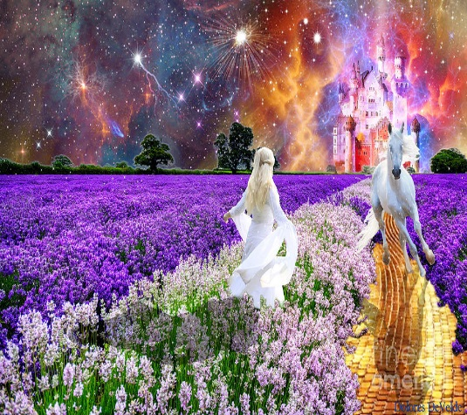
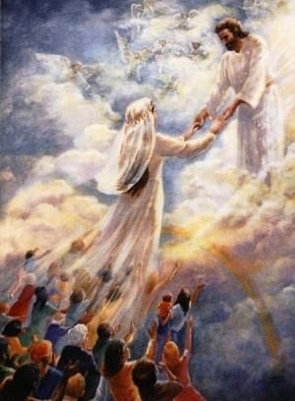
Persecution | Perfection
Winter stagnation(2:11) | The singing of spring(season)(2:11)
Foxes and little foxes that ruin vineyards(2:15) | Pleasant fruits of all manner – New and Old(7:13)
The slackness of night(5:2) | Holding the Groom tight without letting him go again(3:4)
The silent keepers (Un assisting)(5:7) | Un Quenchable quest to find the Groom(5:6)

Slide 5
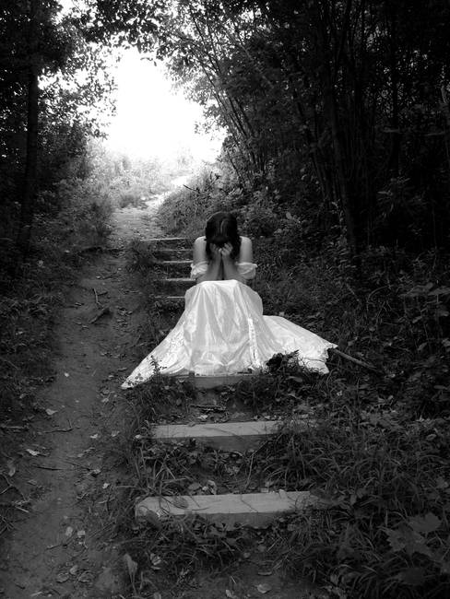
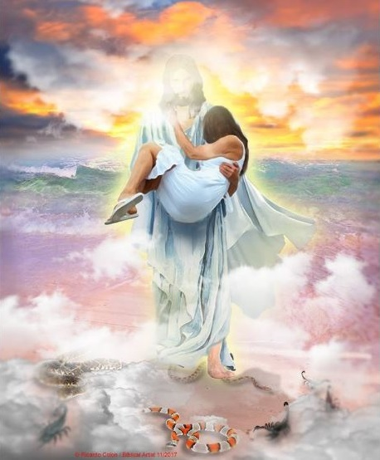
Persecution | Perfection
The scares of night(3:8) | Being carried in the Couch(3:7)
The Mountains of Leopards and the dens of Lions(4:8) | Made as the chariots of Amminadab(6:12)
Self – Debilities (Fraility 5 ,6) | Sustainable faith (Unconquerable) (6:3)

Slide 6

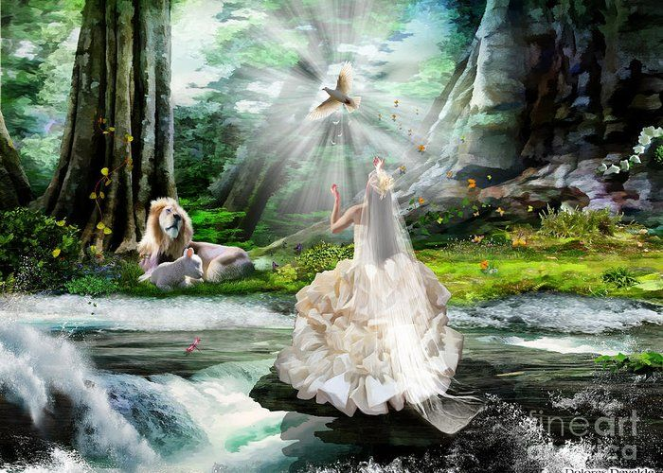
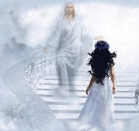
Persecution | Perfection
Blows and wounds(5:7) | Fair and Pleasant with all the delights.(7:6)
Being despised (8:1) | Unique state; The only one ; The dearest one (6:9)
Birth pangs (8:5) | To become multitudes (A Holy Nation and Royal Priesthood)(7:13)

Slide 7
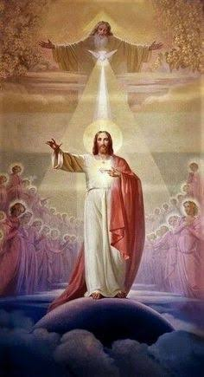
May the Holy Spirit Father Bless and Establish all of us to be His Bride.
AMEN

